Slide 1
Advanced Image Analysis
2017-2018, 2nd semester
Intensity transformations
Alessandro Bria
Contract Professor
and Post-doc Researcher
email: a.bria@unicas.it

Slide 2
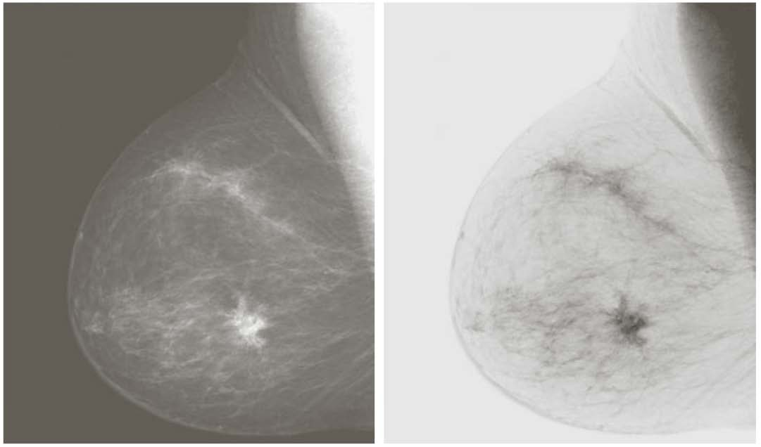
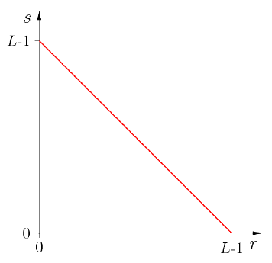
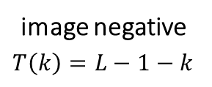


Intensity transformations
also called point-processing
simple to implement
algorithms, functions, look-up-tables
used to enhance images that are devoted to visual processing
no general rule for stating the optimality
application/user-dependent
often designed based on the properties of the image histogram
$$T$$
image negative
$$T\left(k\right)=L−1−k$$
$$k$$

Slide 3
Image histogram

Slide 4
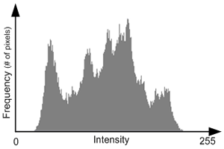


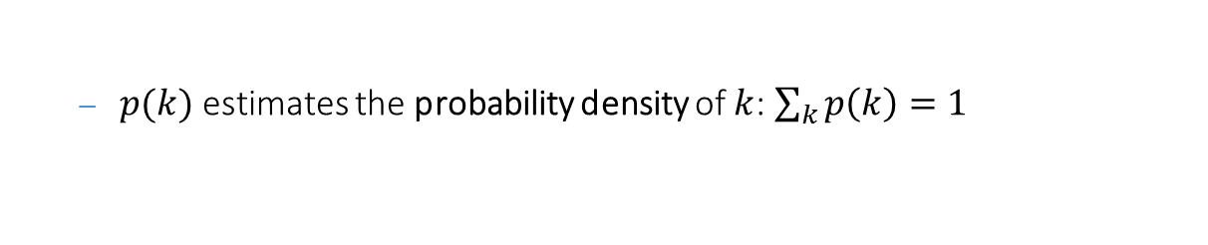
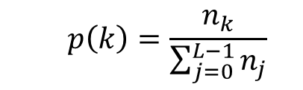
Histogram
a histogram represents the distribution of (graylevel) intensities in the image
the most important basic tool for image processing
the histogram of an $L$-valued image is a discrete function
where $n_{k}$ is the number of pixels with intensity $k$
$$h\left(k\right)=n_{k}, k∈[0,…,L−1]$$
often it is preferable to consider the histogram normalized with respect to the number of pixels
$$p\left(k\right)=\frac{n_{k}}{\sum_{j=0}^{L−1}{n_{j}}}$$
$p(k)$ estimates the probability density of $k$: $\sum_{k}{p\left(k\right)=1}$

Slide 5
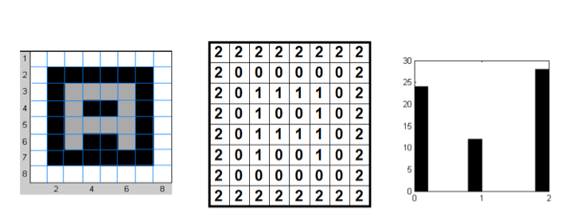
An example of histogram computation
image
graylevels
histogram

Slide 6
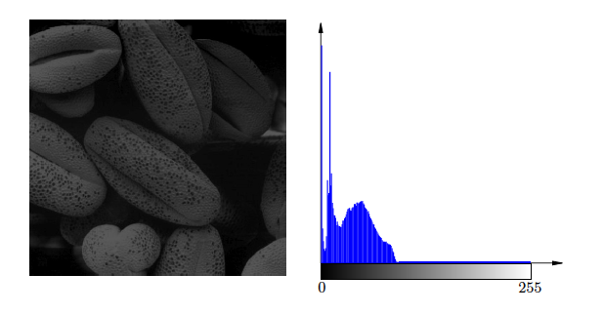
Dark image
the histogram components are localized to low intensity values

Slide 7
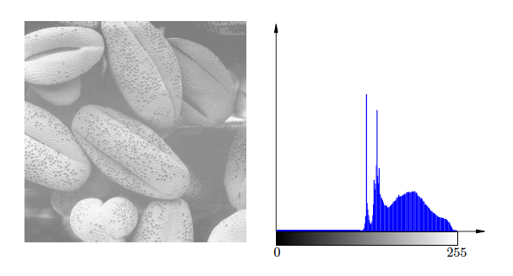
Bright image
the histogram components are localized to high intensity values

Slide 8
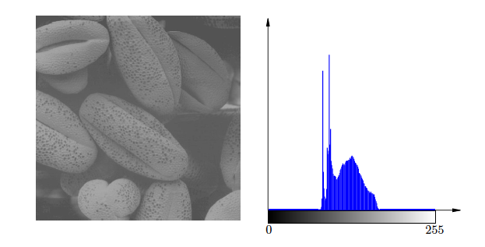
Low contrast image
the histogram components are localized in a narrow region of the intensity values

Slide 9
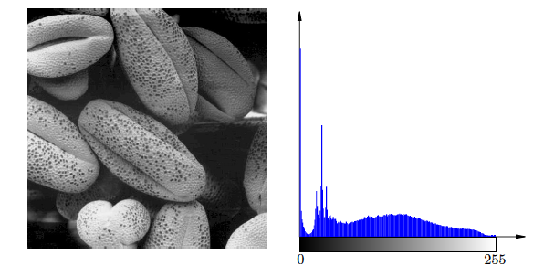
High contrast image
the histogram components are distributed over all the intensity range
this is the effect pursued by the histogram based intensity transformations

Slide 10
Contrast Enhancement

Slide 11
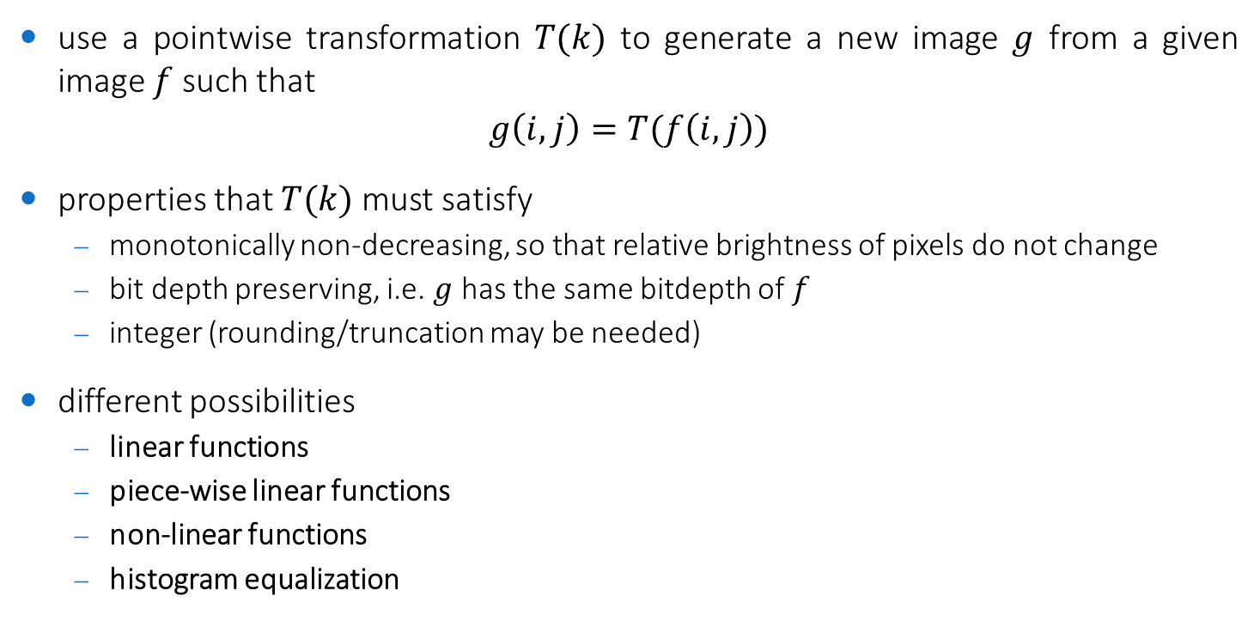
Contrast enhancement
use a pointwise transformation $T(k)$ to generate a new image $g$ from a given image $f$ such that
$$g\left(i,j\right)=T(f\left(i,j\right))$$
properties that $T(k)$ must satisfy
monotonically non-decreasing, so that relative brightness of pixels do not change
bit depth preserving, i.e. $g$ has the same bitdepth of $f$
integer (rounding/truncation may be needed)
different possibilities
linear functions
piece-wise linear functions
non-linear functions
histogram equalization

Slide 12
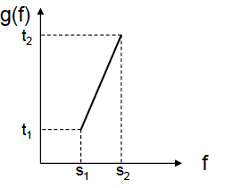
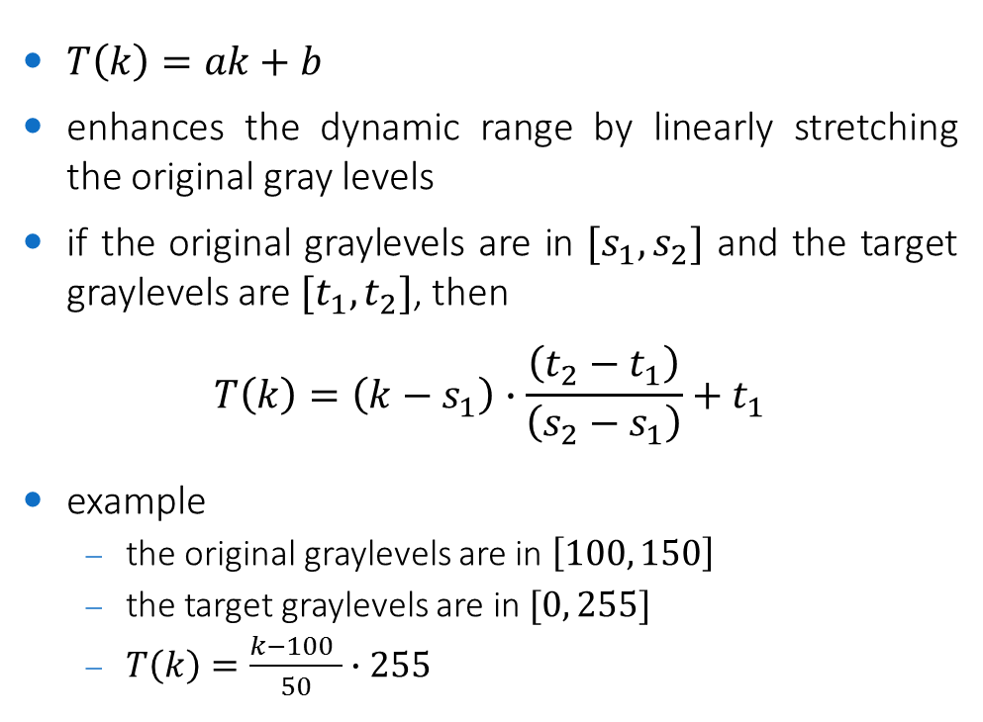


Linear stretching
$T\left(k\right)=ak+b$
enhances the dynamic range by linearly stretching the original gray levels
if the original graylevels are in $[s_{1},s_{2}]$ and the target graylevels are $[t_{1},t_{2}]$, then
$$T\left(k\right)=\left(k−s_{1}\right)∙\frac{\left(t_{2}−t_{1}\right)}{\left(s_{2}−s_{1}\right)}+t_{1}$$
example
the original graylevels are in $\left[100, 150\right]$
the target graylevels are in $[0, 255]$
$T\left(k\right)=\frac{k−100 }{50}∙255$
$$T$$
$$k$$
in this case we refer to the linear stretching transformation as image normalization

Slide 13
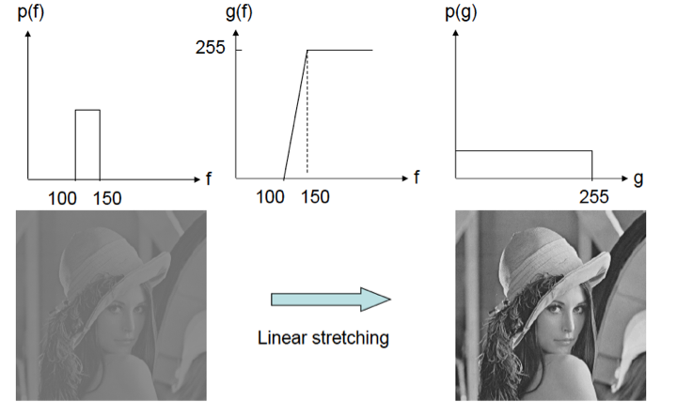






Linear stretching
$$h_{f}(k)$$
$$T(k)$$
$$h_{g}(k)$$
$$k$$
$$k$$
$$k$$

Slide 14
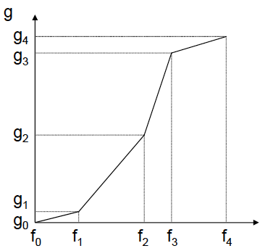













Piecewise linear stretching
$N$ segments for input and output
$$T\left(k\right)=\left(k−s_{j}\right)∙\frac{\left(t_{j+1}−t_{j}\right)}{\left(s_{j+1}−s_{j}\right)}+t_{j}$$
for $s_{j}<k≤s_{j+1}$
$j=0,1,…,N−1$
$$T$$
$$t_{4}$$
$$t_{3}$$
$$t_{2}$$
$$t_{1}$$
$$t_{0}$$
$$k$$
$$s_{0}$$
$$s_{1}$$
$$s_{2}$$
$$s_{3}$$
$$s_{4}$$

Slide 15
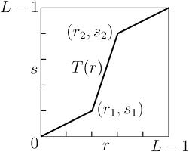
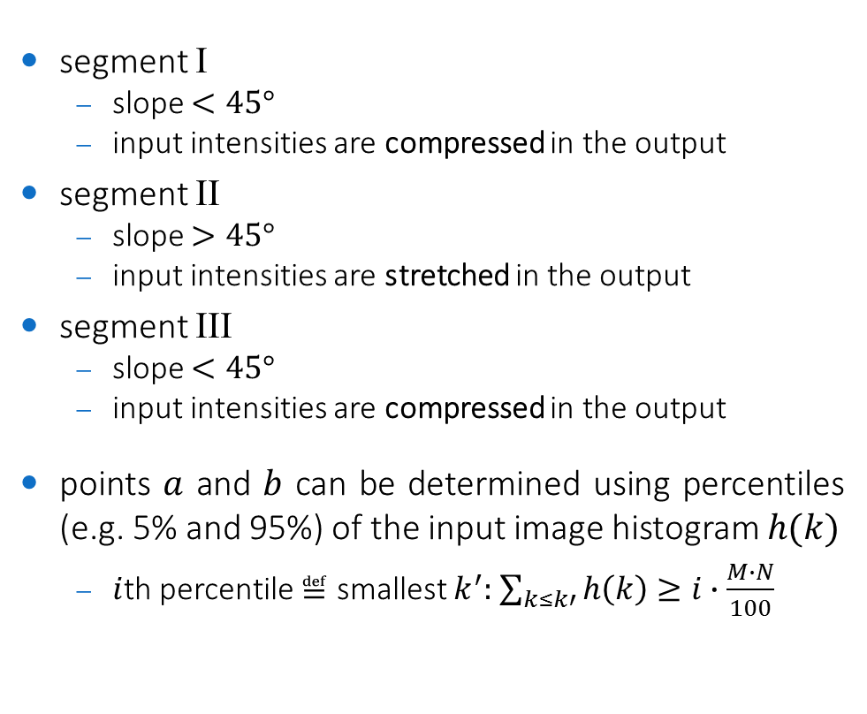


Piecewise linear stretching with $N=3$
segment I
slope $<45°$
input intensities are compressed in the output
segment II
slope $>45°$
input intensities are stretched in the output
segment III
slope $<45°$
input intensities are compressed in the output
points $a$ and $b$ can be determined using percentiles (e.g. 5% and 95%) of the input image histogram $h(k)$
$i$th percentile $≝$ smallest $k^{′}:$ $\sum_{k≤k′}{h\left(k\right)≥i∙\frac{M∙N}{100}}$
III
II
I
$$a$$
$$b$$
I
II
III

Slide 16
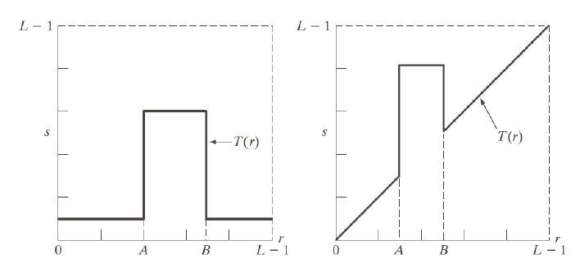
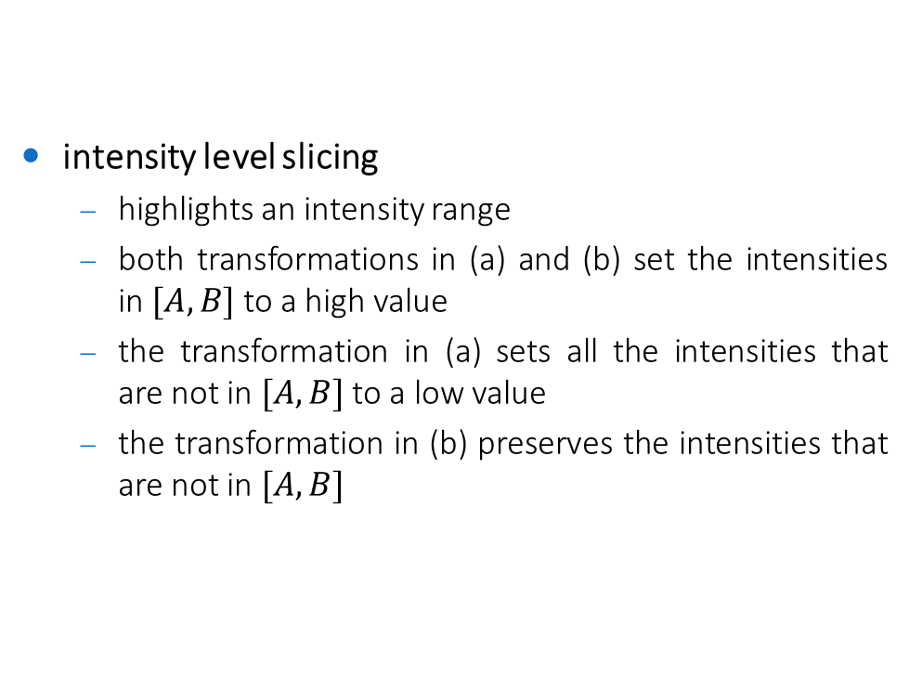
Piecewise linear stretching (special case)
intensity level slicing
highlights an intensity range
both transformations in (a) and (b) set the intensities in $[A,B]$ to a high value
the transformation in (a) sets all the intensities that are not in $[A,B]$ to a low value
the transformation in (b) preserves the intensities that are not in $[A,B]$
(a)
(b)

Slide 17
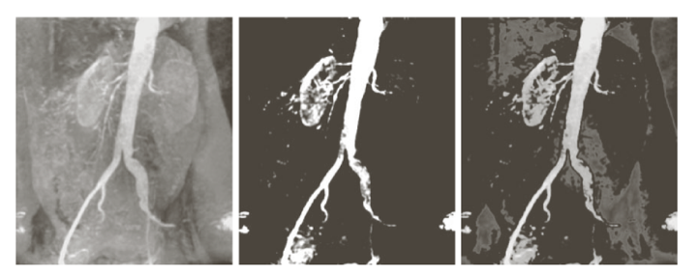

Piecewise linear stretching (special case)
intensity level slicing
highlights an intensity range
both transformations in (a) and (b) set the intensities in $[A,B]$ to a high value
the transformation in (a) sets all the intensities that are not in $[A,B]$ to a low value
the transformation in (b) preserves the intensities that are not in $[A,B]$
(a)
(b)

Slide 18
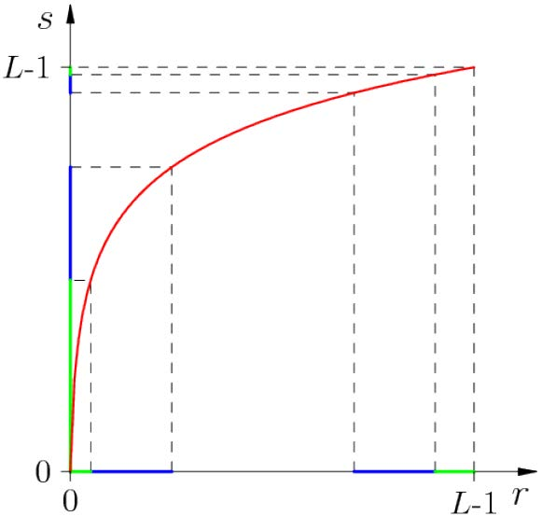
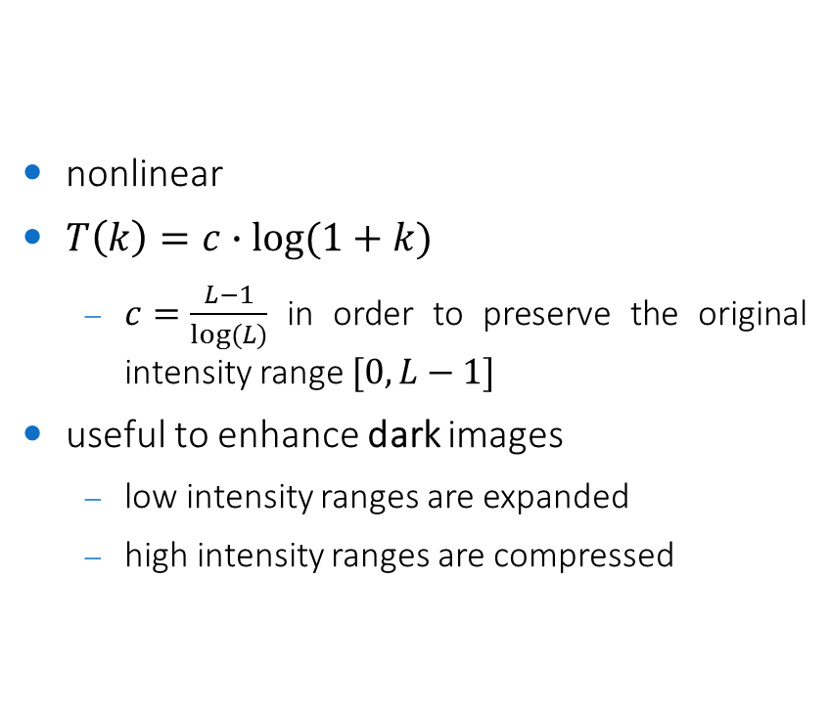


Logarithmic transformations
nonlinear
$T\left(k\right)=c∙log⁡(1+k)$
$c=\frac{L−1}{log⁡(L)}$ in order to preserve the original intensity range $[0,L−1]$
useful to enhance dark images
low intensity ranges are expanded
high intensity ranges are compressed
$$T$$
$$k$$

Slide 19
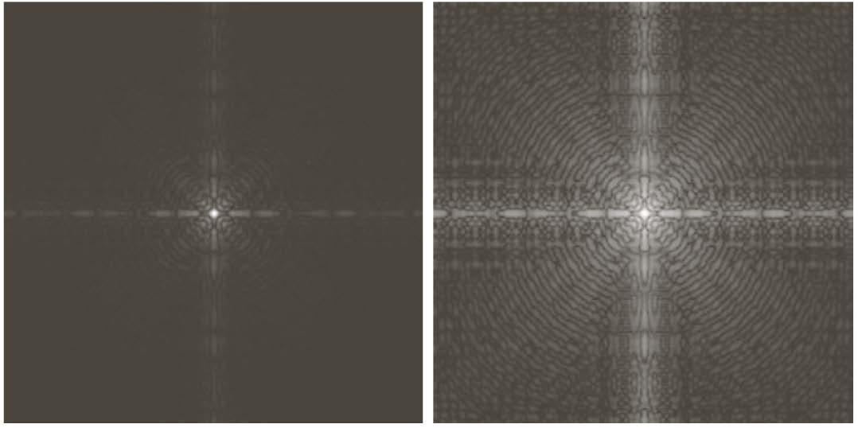
Logarithmic transformations (example)
original
log-transformed

Slide 20
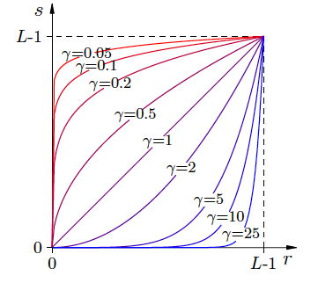
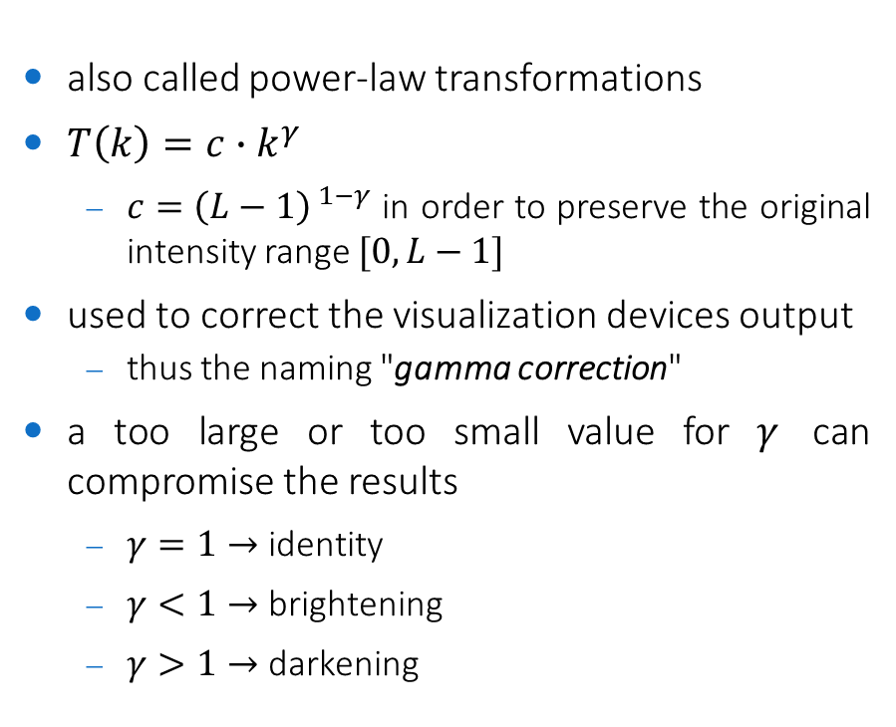


Gamma transformations
also called power-law transformations
$T\left(k\right)=c∙k^{γ}$
$c={\left(L−1\right)}^{ 1−γ}$ in order to preserve the original intensity range $[0,L−1]$
used to correct the visualization devices output
thus the naming "gamma correction"
a too large or too small value for $γ$ can compromise the results
$γ=1→$ identity
$γ<1→$ brightening
$γ>1→$ darkening
$$T$$
$$k$$

Slide 21
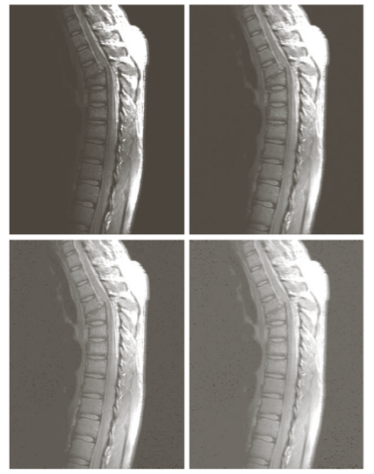


Gamma transformations (brightening)
original image
gamma-transformed with $γ=0.6$
gamma-transformed with $γ=0.4$
gamma-transformed with $γ=0.3$

Slide 22
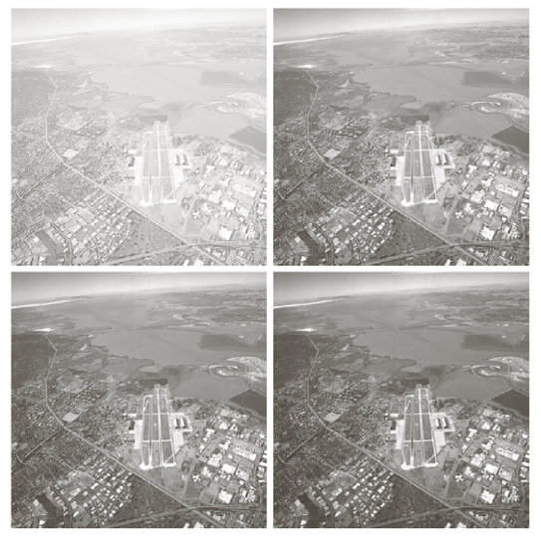

Gamma transformations (darkening)
original image
gamma-transformed with $γ=3$
gamma-transformed with $γ=4$
gamma-transformed with $γ=5$

Slide 23
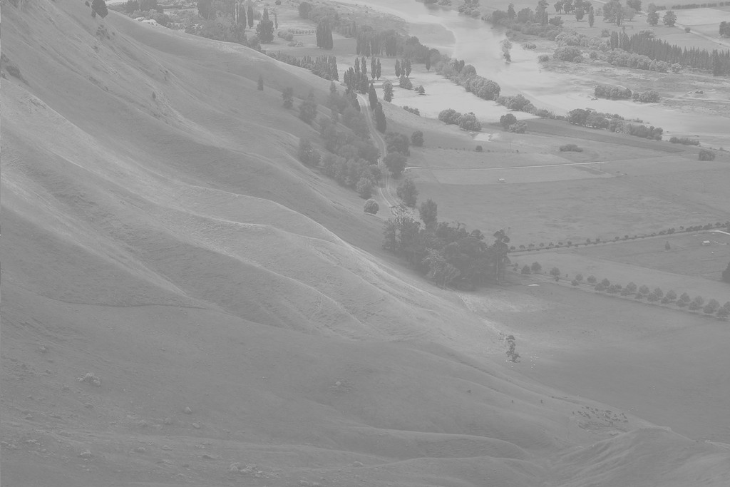
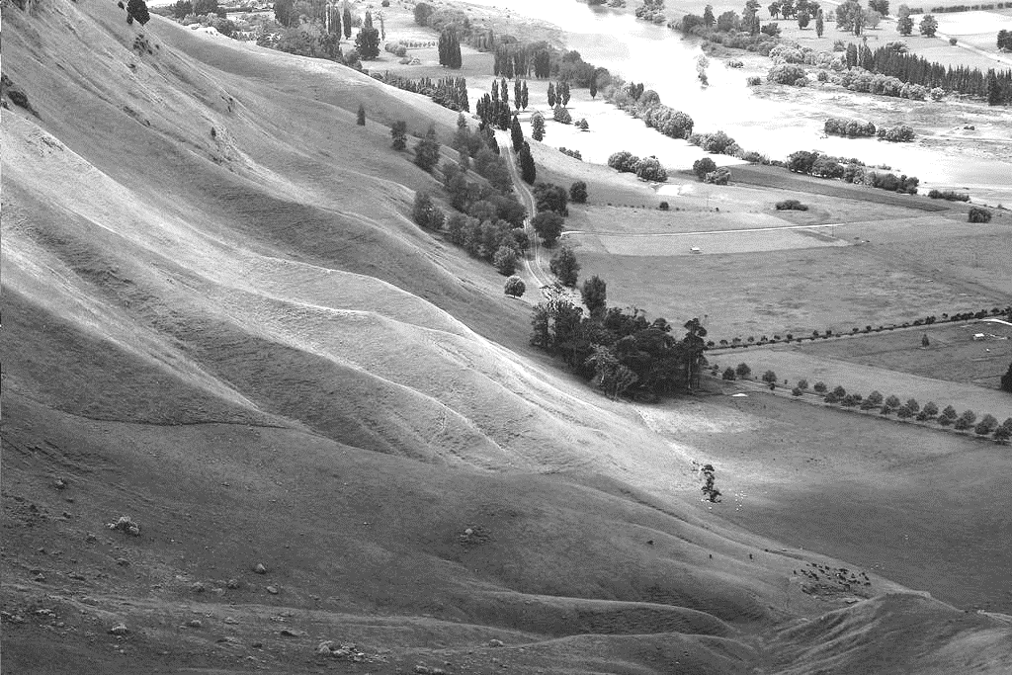
Exercise
implement in C++/OpenCV all contrast enhancement techniques viewed so far and apply them on a low-contrasted image
design a basic UI with trackbars to set parameters
also display the image histogram using
cv::Mat ucas::imhist(const cv::Mat & image)
a low-contrasted image can be found at
std::string(EXAMPLE_IMAGES_PATH) + "/lowcontrast.png"
solution in /exercises/linear-stretching-ui.cpp
solution in /exercises/nonlinear-ui.cpp

Slide 24
Histogram Equalization

Slide 25
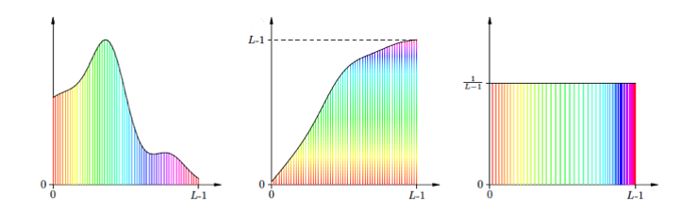
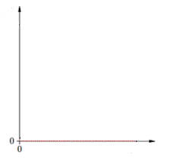





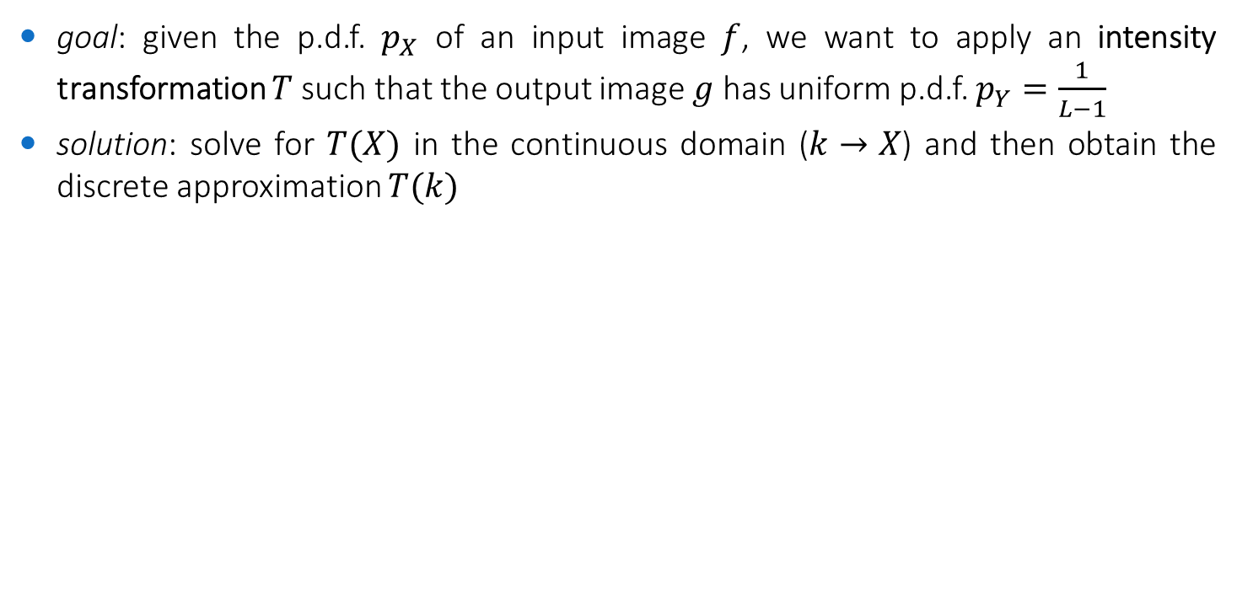

Definition
goal: given the p.d.f. $p_{X}$ of an input image $f$, we want to apply an intensity transformation $T$such that the output image $g$ has uniform p.d.f. $p_{Y}=\frac{1}{L−1}$
solution: solve for $T(X)$ in the continuous domain ($k→X$) and then obtain the discrete approximation $T(k)$
$$p_{X}$$
$$p_{Y}$$
$$T$$
?
$$X$$
$$Y$$
$$X$$
input
desired output
solution

Slide 26
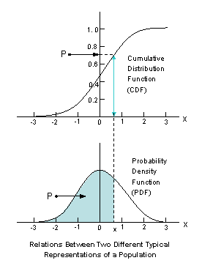
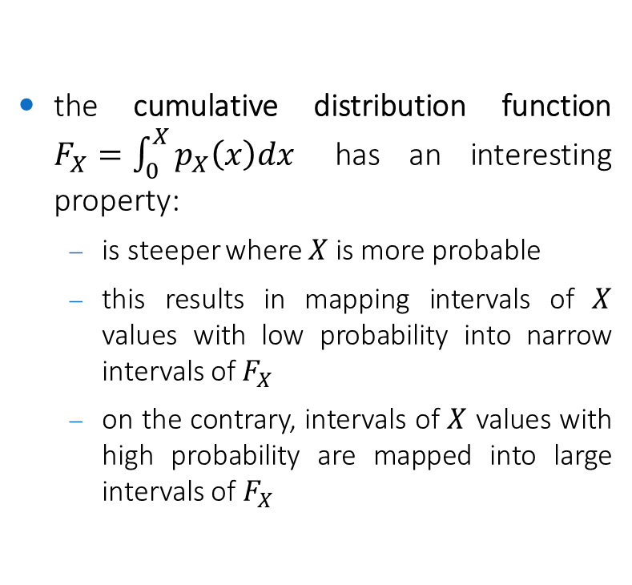
Cumulative Distribution Function
the cumulative distribution function $F_{X}=\int_{0}^{X}{p_{X}\left(x\right)dx}$ has an interesting property:
is steeper where $X$ is more probable
this results in mapping intervals of $X$ values with low probability into narrow intervals of$F_{X}$
on the contrary, intervals of $X$ values with high probability are mapped into large intervals of $F_{X}$

Slide 27
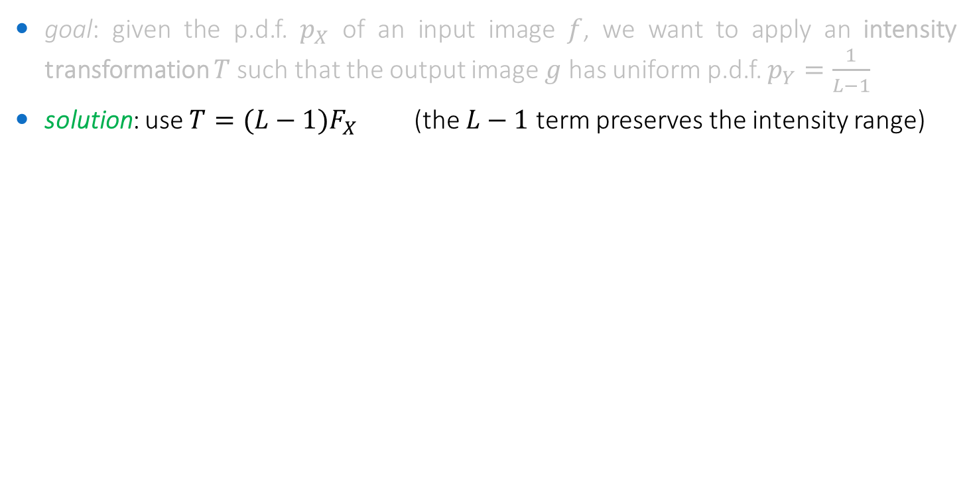
Solution
goal: given the p.d.f. $p_{X}$ of an input image $f$, we want to apply an intensity transformation $T$such that the output image $g$ has uniform p.d.f. $p_{Y}=\frac{1}{L−1}$
solution: use $T={(L−1)F}_{X}$ (the $L−1$ term preserves the intensity range)
$$p_{X}$$
$$p_{Y}$$
$$T$$
$$X$$
$$Y$$
$$X$$
input
desired output
solution

Slide 28
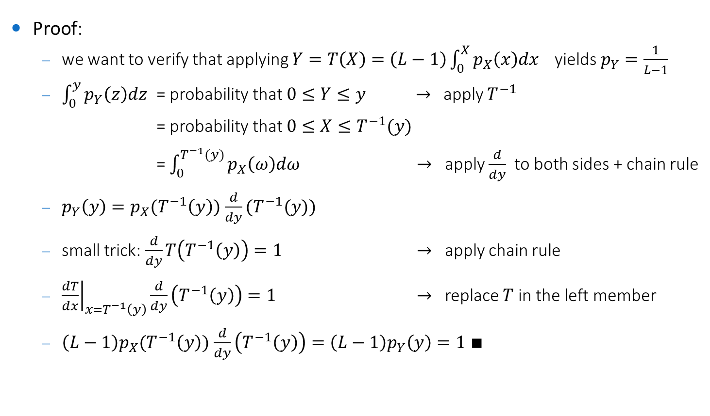
Proof (for the continuous case)
Proof:
we want to verify that applying $Y=T\left(X\right)=\left(L−1\right)\int_{0}^{X}{p_{X}\left(x\right)dx}$yields $p_{Y}=\frac{1}{L−1}$
$\int_{0}^{y}{p_{Y}\left(z\right)dz}$ = probability that $0≤Y≤y$ $→$ apply $T^{−1}$
= probability that $0≤X≤T^{−1}(y)$
= $\int_{0}^{T^{−1}(y)}{p_{X}\left(ω\right)dω}$ $→$ apply $\frac{d}{dy}$ to both sides + chain rule
$p_{Y}\left(y\right)=p_{X}(T^{−1}\left(y\right))$ $\frac{d}{dy}(T^{−1}(y))$
small trick: $\frac{d}{dy}T\left(T^{−1}\left(y\right)\right)=1$ $→$ apply chain rule
${\left.\frac{dT}{dx}\right|}_{x=T^{−1}\left(y\right)}\frac{d}{dy}\left(T^{−1}\left(y\right)\right)=1$ $→$ replace $T$ in the left member
$\left(L−1\right)p_{X}(T^{−1}\left(y\right))$ $\frac{d}{dy}\left(T^{−1}\left(y\right)\right)=\left(L−1\right)p_{Y}\left(y\right)=1 ∎$

Slide 29
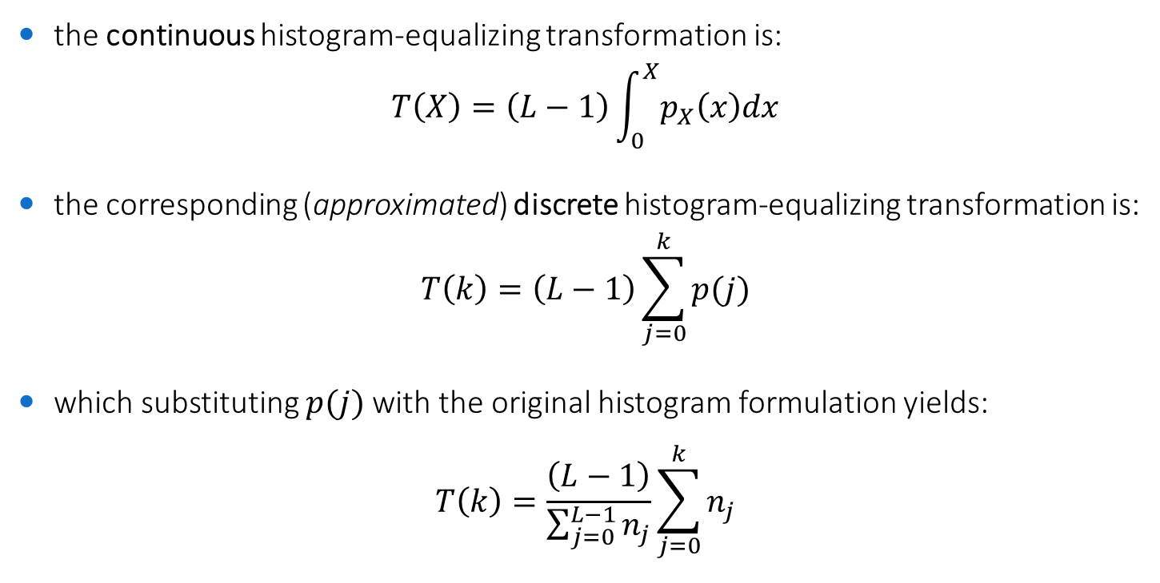
Discrete histogram equalization
the continuous histogram-equalizing transformation is:
$$T\left(X\right)=\left(L−1\right)\int_{0}^{X}{p_{X}\left(x\right)dx}$$
the corresponding (approximated) discrete histogram-equalizing transformation is:
$$T\left(k\right)=\left(L−1\right)\sum_{j=0}^{k}{p(j)}$$
which substituting $p(j)$with the original histogram formulation yields:
$$T\left(k\right)=\frac{\left(L−1\right)}{\sum_{j=0}^{L−1}{n_{j}}}\sum_{j=0}^{k}{n_{j}}$$

Slide 30
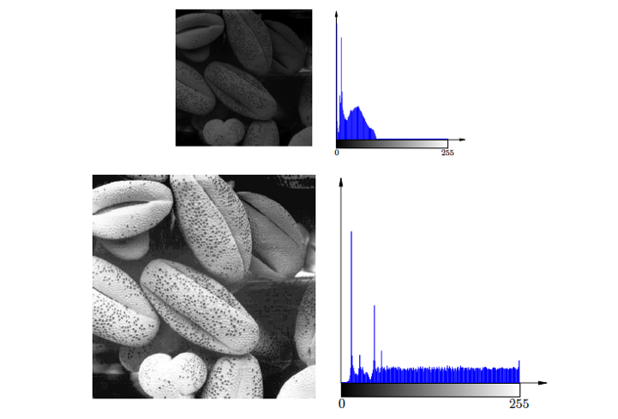
Example: dark image equalization

Slide 31
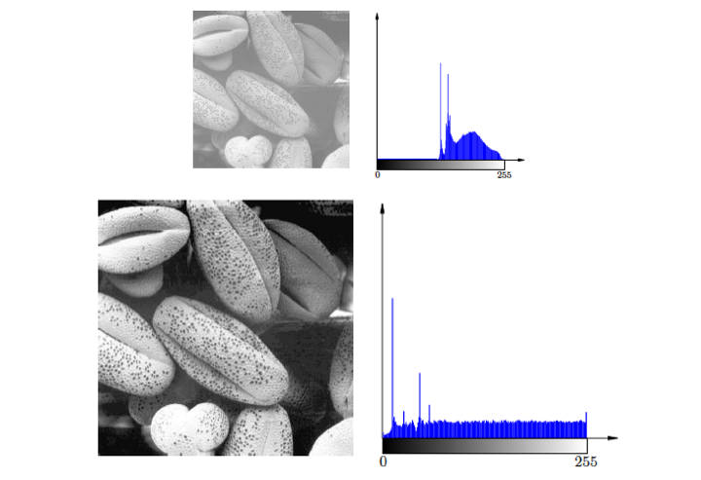
Example: bright image equalization

Slide 32
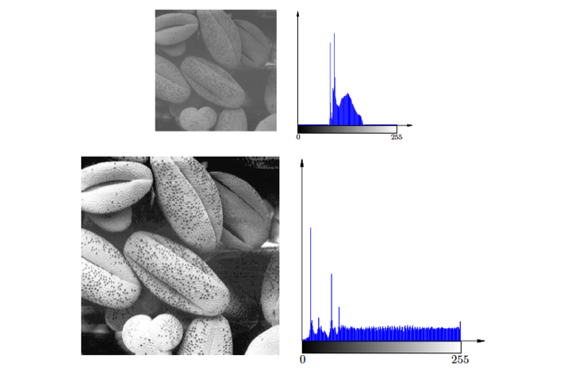
Example: low contrast image equalization

Slide 33
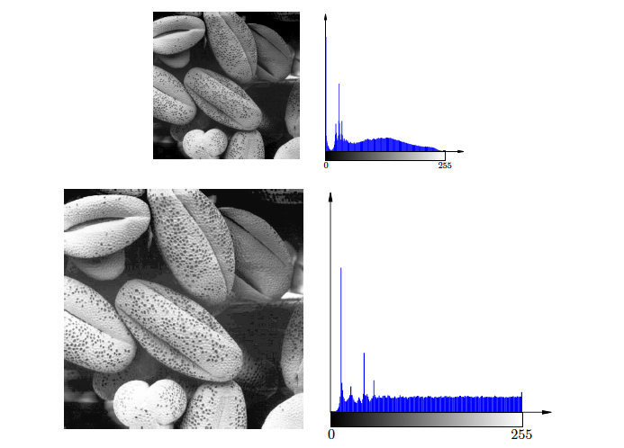
Example: high contrast image equalization

Slide 34
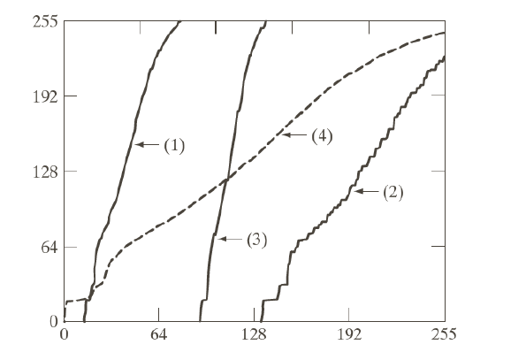
Examples
the transformation of each image maps values from the range of the original images to the whole range of intensity levels
the transformation for (4) is close to the identity

Slide 35
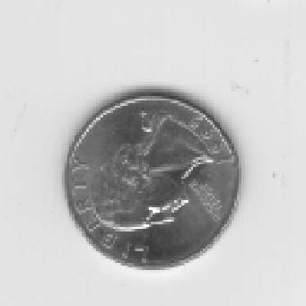
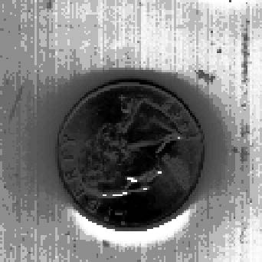
Should HE be always applied?
of course, no
if the image has a bimodal-like histogram, equalization may worsen the contrast
this is the case of dark/bright objects on homogeneous bright/dark background
original
equalized

Slide 36
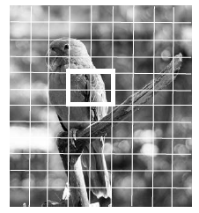

Adaptive Histogram Equalization (AHE)
histogram equalization based on a histogram obtained from a portion of the image
preserves and enhances local properties
e.g. using a tiling approach
subdivide into overlapping regions
apply histogram equalization within each tile
mitigate blocking effect by smooth blending between neighboring tiles
contrast limited AHE (CLAHE)
limit contrast expansion in flat regions of the image by clipping histogram values

Slide 37




Examples
original
HE
CLAHE $16×16$

Slide 38



Examples
original
HE
CLAHE $16×16$

Slide 39
Exercise
implement in C++/OpenCV both global and adaptive histogram equalization and apply them on a low-contrasted image
design a basic UI with trackbars to set parameters
also display the image histogram using
cv::Mat ucas::imhist(const cv::Mat & image)
a low-contrasted image can be found at
std::string(EXAMPLE_IMAGES_PATH) + "/lowcontrast.png"
solution in /exercises/histogram-equalization-ui.cpp

